Slide 1
Medical Cost Analysis
Anees Bagus

Slide 2
Why Does it Matter
Harm reduction
Longevity
Increase quality of life
Reduce costs

Slide 3
INtroduction
Medical Cost Personal Dataset (https://www.kaggle.com/mirichoi0218/insurance)
Description of Dataset:
Age: An integer representing the age of the primary beneficiary (excluding those above 64 years, covered by the government).
Sex: Gender of the policy holder, categorized as male or female.
BMI: Body Mass Index (BMI) indicates relative weight status, calculated as weight (in kg) divided by height (in meters) squared. The optimal BMI range is 18.5 to 24.9.
Children: An integer indicating the count of children or dependents covered by the insurance plan.
Smoker: A binary categorization indicating whether the insured person smokes tobacco (yes or no).
Region: Geographical location of the beneficiary within the U.S., categorized into northeast, southeast, southwest, or northwest regions.
Charges: Medical costs billed to health insurance for individuals.

Slide 4
Questions
Do people who smoke end up paying more for their health costs than those who don't smoke?
Does being male or female affect how much someone weighs overall?
Do individuals with higher weight cause higher costs compared to those who weigh less?
Does how old someone is affect how much they use their health insurance?
Does having more family members to cover on insurance affect how much insurance is used?

Slide 5
Objective hypothesis
H0: μ1<=μ2, Smokers, on average, are charged less than or equal to nonsmokers
Ha: μ1>μ2, Smokers, on average, are charged greater than nonsmokers
H0:μ1−μ2=0 There is no difference between the BMI of Male and BMI of female.
Ha:μ1−μ2!=0 There is difference between the BMI of Male and BMI of female.
H0: Smokers proportions are not significantly different across different regions.
Ha: Smokers proportions are different across different regions.
H0: μ1 = μ2 = μ3 The mean BMI of women, regardless of children, is the same
Ha: At least one of mean BMI women is not same.

Slide 6
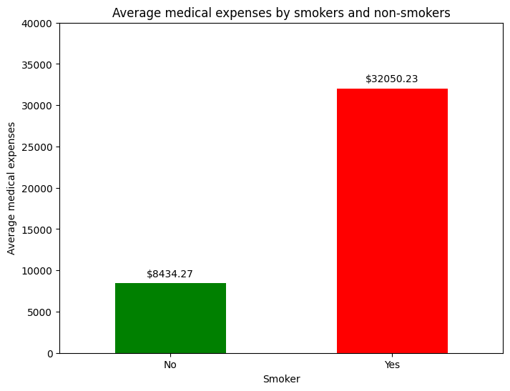
Do people who smoke end up paying more for their health costs than those who don't smoke?
Based on the provided data, we can conclude that people who smoke "yes" have a significantly higher average medical expenses approximately 32,050.23 compared to those who do not smoke "no", who have a much lower average medical expenses approximately 8,434.27. This indicates that smokers tend to pay considerably more for their healthcare costs than non- smokers. bold text

Slide 7
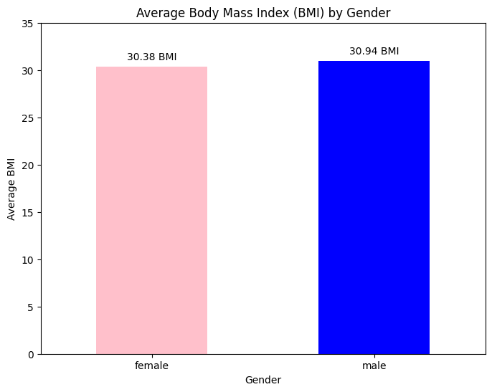
Does being male or female affect how much someone weighs overall?
Based on the provided data, we can conclude that, on average, there does not appear to be a substantial difference in Body Mass Index (BMI) between men and women. Women have an average BMI of approximately 30.38, while men have an average BMI of around 30.94. This suggests that, in general terms, gender does not seem to significantly affect the weight or BMI of individuals in this dataset.

Slide 8
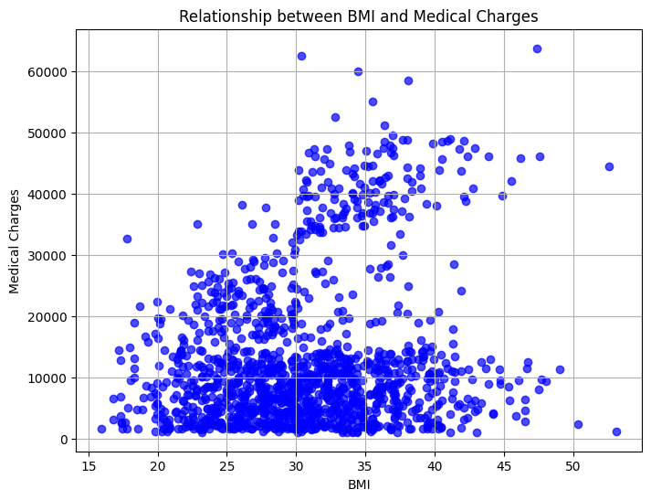
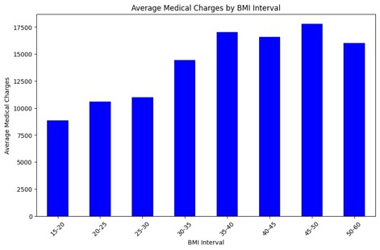
Do individuals with higher weight cause higher costs compared to those who weigh less?
Based on the provided data, we can observe a clear trend that the average medical charges tend to increase as Body Mass Index (BMI) of individuals increases. The BMI intervals were divided into groups of 5 units (e.g., 15-20, 20-25, 25-30, etc.), and the average medical charges in each group were calculated. Those with a BMI in the 45-50 range have the highest average medical charges, at approximately US 17,815.04, closely followed by those with a BMI in the 35-40 range, which have an average of about US 17,022.26. This suggests that individuals with higher BMI tend to have higher medical costs compared to those with lower BMI. It's important to note that this is a correlational observation and doesn't necessarily imply a causal relationship. Several factors can influence medical charges, and BMI is just one of them. Other factors such as lifestyle, medical history, and health habits can also play a significant role in medical expenses.

Slide 9
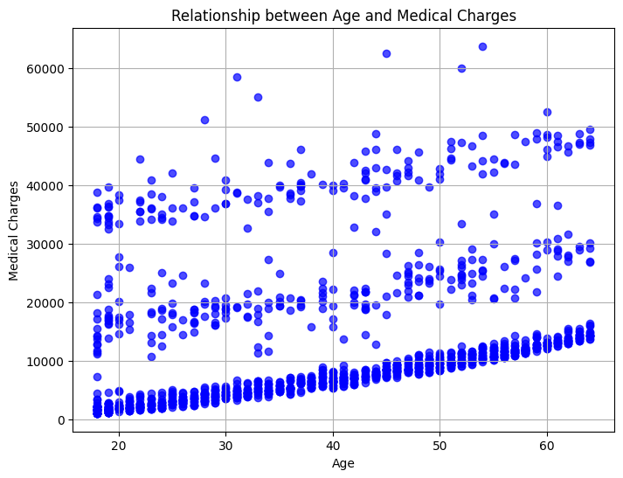
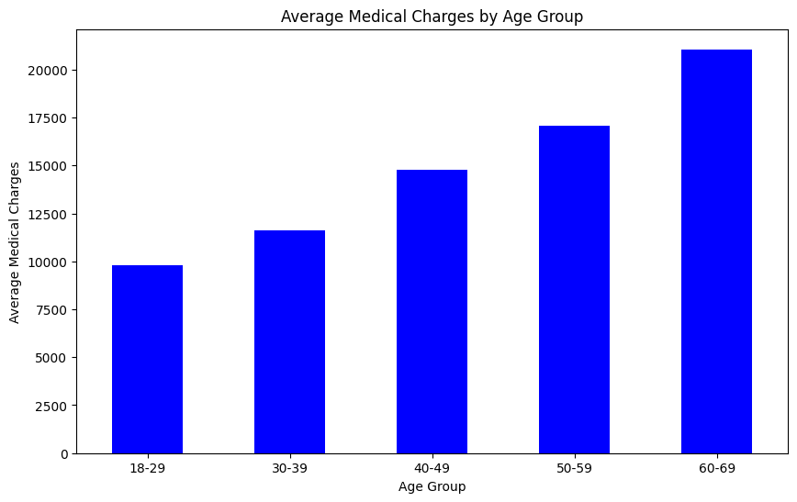
Does how old someone is affect how much they use their health insurance?
Based on the provided data, we can observe a clear trend that the average medical charges tend to increase as individuals' age increases. The data is grouped into age ranges, and the average medical charges in each age group have been calculated.
Individuals in the 60-69 age group have the highest average medical charges, with an average of approximately 21,063.16. This is followed by individuals in the 50-59 age group, with an average of about 17,062.29. As the age group decreases, the average medical charges also decrease.
This suggests that age does have an impact on how much individuals use their health insurance, with older individuals generally incurring higher medical charges compared to younger individuals. However, it's important to note that this is a correlation, and various other factors may contribute to these differences in medical charges, such as pre-existing health conditions and healthcare utilization patterns.

Slide 10
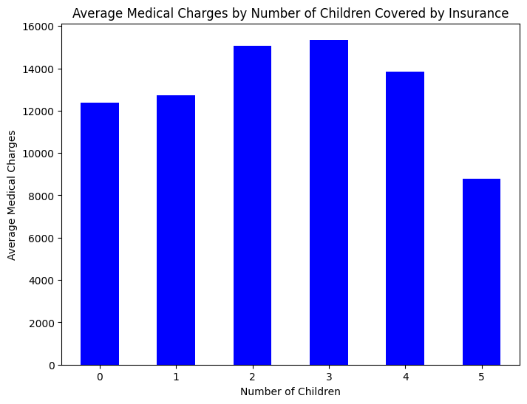
Does having more family members to cover on insurance affect how much insurance is used?
Based on the provided data, it appears that the average medical charges tend to vary based on the number of children covered by insurance. Interestingly, there appears to be a decrease in average expenses when going from 3 to 5 children. However, it's important to note that this decrease doesn't necessarily follow a linear logic and may be due to data variations or specific sample factors.
This irregular variation suggests that the number of children covered by insurance is not the only factor influencing medical expenses. Other factors, such as individual health and patterns of healthcare utilization, also play a significant role in determining each person's medical expenses. Therefore, while there is a general trend of increasing expenses with an increase in the number of children, this relationship may not be direct and linear, and other individual factors may also have an influence.

Slide 11
Prove (or disprove) that the medical claims made by the people who smoke is greater than those who do not?
Objective Hypothesis:
H0: μ1<=μ2, Smokers, on average, are charged less than or equal to nonsmokers
Ha: μ1>μ2, Smokers, on average, are charged greater than nonsmokers
T-test performed to show p-value, which will reject, or fail to reject the hypothesis: The difference in claims between smokers and nonsmokers is statistically significant. p value: 8.271435842179102e-283
Conclusion: Based on the statistical analysis of the provided dataset, there is no significant difference in smokers versus nonsmokers between males and females. The p-value, given the great exponentiality (283), is well below the commonly chosen significance level of 0.05.
Therefore, we do have sufficient statistical evidence to conclude that there is a difference between smokers and nonsmokers medical claims. This means that smoking does have an influence on medical claims

Slide 12
Prove (or disprove) with statistical evidence that the BMI of females is different from that of males.
Objective Hypothesis:
H0:μ1−μ2=0 There is no difference between the BMI of Male and BMI of female.
Ha:μ1−μ2!=0 There is difference between the BMI of Male and BMI of female.
T-test performed to show p-value, which will reject, or fail to reject the hypothesis: The difference in claims between smokers and nonsmokers is statistically significant. p value: 0.0899
Conclusion: Based on the statistical analysis of the provided dataset, there is no significant difference in BMI (Body Mass Index) between males and females. The p-value, a measure of statistical significance, is 0.0899, which is greater than the commonly chosen significance level of 0.05. Therefore, we do not have sufficient statistical evidence to conclude that there is a difference in BMI between the two genders in this dataset

Slide 13
Is the proportion of smokers significantly different across regions?
Objective Hypothesis:
H0: Smokers proportions are not significantly different across different regions.
Ha: Smokers proportions are different across different regions.
Here we are comparing two different categorical variables, smoker, and regions. A Chi-square Test will be performed and the results are as follows: There is no statistical evidence to conclude that the proportion of smokers is different. P-value: 0.06171954839170547
The results of the Chi-square test indicate that there is no statistically significant evidence to conclude that the proportion of smokers differs significantly across different regions. The p- value obtained from the test is approximately 0.0617, which is greater than the commonly chosen significance level (alpha) of 0.05.
Therefore, based on this analysis, we do not have sufficient statistical evidence to reject the null hypothesis (H0), which suggests that the proportions of smokers are not significantly different across regions. In other words, the data does not provide support for the idea that smoking habits vary significantly depending on the region.
It's important to note that while the p-value is slightly above the chosen significance level, the interpretation may depend on the specific context and the level of confidence required for the analysis. If a stricter significance level were chosen, the conclusion might differ.

Slide 14
Is the mean BMI of women with no children, one child, and two children the same?
Objective Hypothesis:
H0: μ1 = μ2 = μ3 The mean BMI of women, regardless of children, is the same
Ha: At least one of mean BMI women is not same.
A One-way ANOVA test will be performed - Equality of population through variances of samples. The results are as follows: There is no statistical evidence to conclude that the mean BMI of women with different numbers of children is different. P-value: 0.6591330886467935
The results of the one-way ANOVA test indicate that there is no statistically significant evidence to conclude that the mean BMI of women with different numbers of children is different. The p- value obtained from the test is approximately 0.6591, which is substantially greater than the commonly chosen significance level (alpha) of 0.05.
Therefore, based on this analysis, we do not have sufficient statistical evidence to reject the null hypothesis (H0), which suggests that the mean BMI of women with no children, one child, and two children is the same. In other words, the data does not provide support for the idea that the number of children has a significant impact on the mean BMI among women in the dataset.
These findings imply that, within the context of the data and the analysis performed, the number of children a woman has does not appear to be associated with significant differences in their mean BMI. However, it's important to consider that other factors not included in this analysis may influence BMI, and further research may be needed to explore any potential relationships.

Slide 15
Why Does this Matter?
Identifying High-Risk Policyholders and Improving Health
Understanding Health Data:
We use advanced data analysis to thoroughly examine the health data of our policyholders. This includes looking at their medical history, claims, and lifestyle choices.
Sorting by Risk:
We then categorize our policyholders into different risk groups. This helps us identify those who might need more attention and support.
Personalized Support:
For individuals at higher risk, we create personalized plans to help them address their specific health needs and challenges.

Slide 16
Suggested Deliverable: Smoking Cessation Program
If we identify that someone is currently a smoker or has a history of smoking-related health issues, we reach out with a program designed to help them quit smoking. We provide resources, counseling, and even offer incentives like reduced premiums or wellness rewards for successfully quitting. This framework is all about using data to better understand our policyholders' health, and then tailoring our support to their unique situations. The smoking cessation program is just one example of how we work to improve health and reduce costs.

